Slide 1

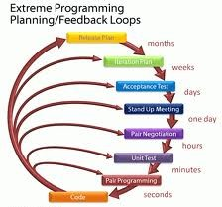
Agile Software Development
Topic: XP Framework
Dr. Nikhil Govil
Associate Professor, Program Coordinator – B.Tech. (CSE), Dept. of CEA

Slide 2

Extreme Programming (XP)
Extreme Programming (XP) is an Agile software development framework that aims to produce higher quality software.
XP is a lightweight, efficient, low-risk, flexible, predictable, scientific, & fun way to develop a software.
XP was developed by Kent Beck in 1990s to address the specific needs of software development by small teams in the face of vague & changing requirements.
It advocates frequent "releases" in short development cycles.

Slide 3
Values of Extreme Programming
XP has simple rules that are based on 5 values:
Communication
Simplicity
Feedback
Respect &
Courage

Slide 4
Principles of Extreme Programming
XP is based on following 5 principles:
Rapid feedback
Assumed simplicity
Incremental changes
Embracing change &
Quality work

Slide 5
Extreme Programming Practices
Extreme programming has been described as having 12 practices, grouped into four areas:
Fine-scale feedback
Pair programming
Planning game
Test-driven development
Whole team
Programmer welfare
Sustainable pace

Slide 6
Extreme Programming Practices
Continuous process
Continuous integration
Refactoring or design improvement
Small releases
Shared understanding
Coding standards
Collective code ownership
Simple design

Slide 7
XP Practices: Fine Scale Feedback
Pair programming
This practice requires two programmers to work jointly on the same code. While the first developer focuses on writing, the other one reviews code, suggests improvements, and fixes mistakes along the way.
Planning game
This is a meeting that occurs at the beginning of an iteration cycle. The development team and the customer get together to discuss and approve a product’s features.
Test-driven development
XP teams practice test-driven development technique (TTD) that entails writing an automated unit test before the code itself.
Whole team/On-site Customer
In XP, the end customer should fully participate in development.

Slide 8
XP Practices: Programmer Welfare / Working Conditions
Sustainable Pace / Programmer’s work conditions
XP projects require developers to work fast, be efficient, and sustain the product’s quality. In XP, the optimal number of work hours must not exceed 45 hours a week.

Slide 9
XP Practices: Continuous Process
Continuous Integration
XP practitioners understand the importance of communication. Programmers discuss which parts of the code can be re-used or shared.
Refactoring or design improvement / Code Refactoring
The goal of this technique is to continuously improve code. Refactoring is about removing redundancy, eliminating unnecessary functions, increasing code coherency, and at the same time decoupling elements.
Small Releases
This practice suggests releasing the first version quickly and further developing the product by making small and incremental updates.

Slide 10
XP Practices: Shared Understanding
Coding Standards
A team must have common sets of coding practices, using the same formats and styles for code writing.
Collective Code Ownership
This practice declares a whole team’s responsibility for the design of a system. Each team member can review and update code.
Simple Design
The best design for software is the simplest one that works. If any complexity is found, it should be removed.

Slide 11
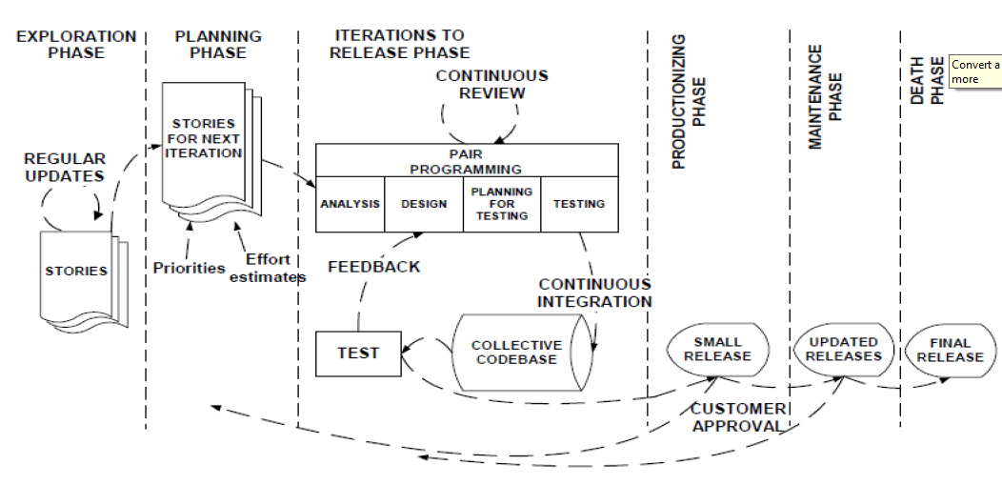
Extreme Programming Framework

Slide 12
When to use XP
XP framework can be applied in following cases:
Highly adaptive development,
Risky projects,
Small teams,
Automated testing,
Active customer participation, etc.

Slide 13
References
Ken Schawber & Mike Beedle, Agile Software Development with Scrum, Pearson, 2008.
Robert C. Martin, Agile Software Development, Principles, Patterns and Practices, Prentice Hall,2002.
Lisa Crispin & Janet Gregory, Agile Testing: A Practical Guide for Testers and Agile Teams, Addison Wesley, 2008.
Alistair Cockburn, Agile Software Development: The Cooperative Game, Addison Wesley, 2006.

Slide 14


